Slide 1
Adoption of IFRS in the Maldives
Mr. Hassan Mohamed - Vice-President

Slide 2
A Corporate Overview
As of 30 June 2022, there are:
20,030
26
Sole Traders
Unlisted SOEs
1,500
10
Partnerships
PLCs
13,251
116
Priavte Companies
Cooperative Societies

Slide 3
PLCs in Maldives
10
18 M
1,608 MN
42,352
PLCs Listed in Maldives Stock Exchange
Value of Shares Traded (USD)
Market Cap (USD)
Investors

Slide 4
A Corporate Overview
Revenue Comparison of 2019
USD
USD
USD
USD
1,507M
479M
1,324M
614M
Government Revenue
Revenue of Tourism Sector
Revenue of Public Limited Companies
Revenue of Unlisted SOEs
Extracted from: Budget Booklet 2022

Slide 5
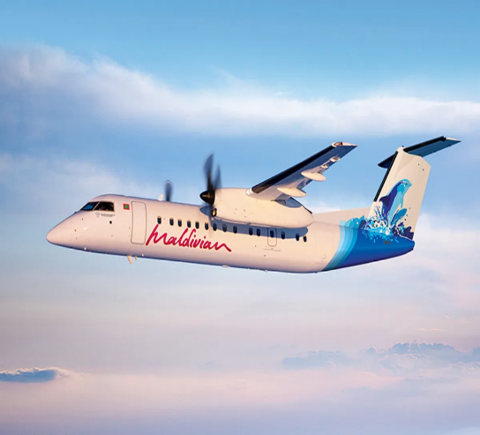
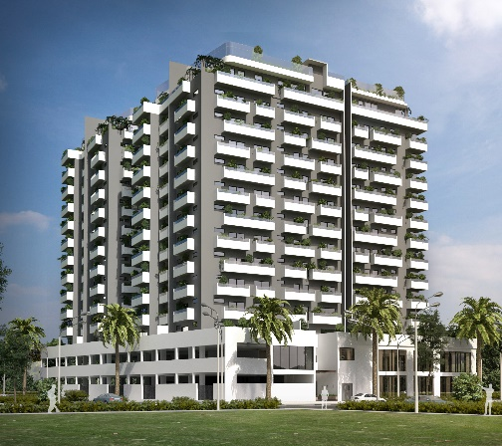
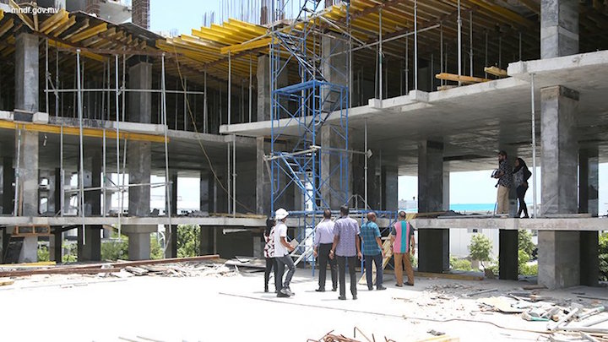
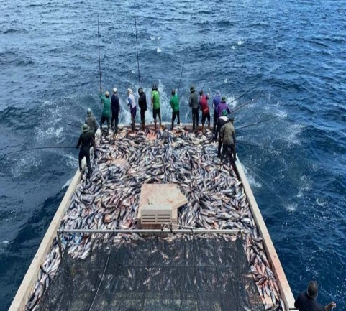
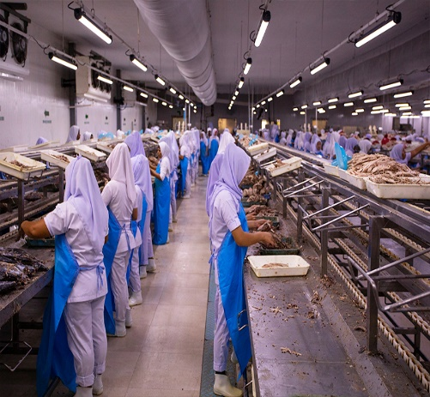
GDP of Sectors - 2019
Total GDP of Maldives : MVR 77.16 B
USD1,315M
USD617M
USD331M
USD322M
Tourism
Transport & Communication
Real Estate
Construction
USD209M
USD180M
USD110M
USD55M
Financial Services
Fisheries
Manufacturing
Agriculture

Slide 6
GDP Per Capita (USD)
GDP Per Capita of USD 10,541 in 2019
12,500
10,541
10,331
10,000
9,651
9,011
9,238
7,500
5,000
2,500
0
2015
2016
2017
2018
2019
Extracted from: Budget Booklet 2023

Slide 7
Revenue of PLCs
Government Revenue
2019 – USD 1,324M
2019 – USD 1,507M
75M
Cash Grants
5%
358M
Non - Tax Revenue
23.8%
707M
185M
179M
132M
1,071M
Tax Revenue
71.2%
13M
10M
9M
Borrowing Inflows
Other Inflows
USD 330M
USD 231M
75M
9M
4M

Slide 8
Adoption of IFRS in the Maldives
Ratification of
Chartered Accountants Act by President.
2020
Companies Act
1996
Started accounting in businesses with the introduction of tourism
Maldives Banking Act No. 24 of 2010
2006
1978
2010
CMDA Corporate Governance Code
2011
Introduction of Business Profit Tax
Notes:
Unofficial Adoption
Financial accounting started in the Maldives from 1978 with the introduction of tourism.
Companies engaged in tourism started accounting as per international accounting standards as mostly international banks financed the resort projects.
Companies’ Act 1996
Requires all companies to prepare books of accounts as per international accounting standards, interpreted as IFRS.
Capital Market Development Authority (CMDA)
The corporate governance code issued by the Capital Market Development Authority requires that all listed companies on the Maldives stock exchange must ensure that their financial statements are prepared based on IFRS Standards.
Prior to AGO, global audit firms through their audits advised private sector companies to adopt IFRSs
Maldives Banking Act Maldives Banking Act No. 24 of 2010
Requires all banks and financial institution to comply with International Accounting Standards.
Upon ratification of Audit Act in 2007, AGO prescribed IFRSs for SOEs
With the BPT Act of MIRA coming into effect (2010), corporates are required to adopt IFRSs
With the establishment of CA Maldives in 2020, the role of setting and enforcing accounting and auditing standards came under the mandate of the Institute
CA Maldives prescribes IFRS and IFRS for SMEs as financial reporting standards in the private sector

Slide 9
Mandate of CA Maldives
Institute formed upon ratification of Chartered Accountants Act by President on 8th September 2020
Responsible to determine and enforce mandatory financial reporting standards and auditing standards for the private sector

Slide 10
Due Process Followed In Adoption of IFRSs
Technical Committee of CA Maldives is tasked with deliberating on technical matters including reporting standards and giving suggestions to Council; as such adoption of auditing and accounting standards
The due process followed by Technical Committee in adoption of IFRSs:
Invited members and key stakeholders to give comments
Responded to their comments
Developed a writ-up on the project incorporating the comments, benefits & costs of adoption and Technical Committee’s recommendations to the Council

Slide 11
Thank you

